Slide 1
Webinar 2: Know Others
Understanding your competitive landscape

Slide 2
Topics
What is the competitive landscape?
Who competes with you?
What are the market opportunities? – PESTLE, Five Forces
How are you placed to take advantage of the opportunities?
Thought for next time

Slide 4
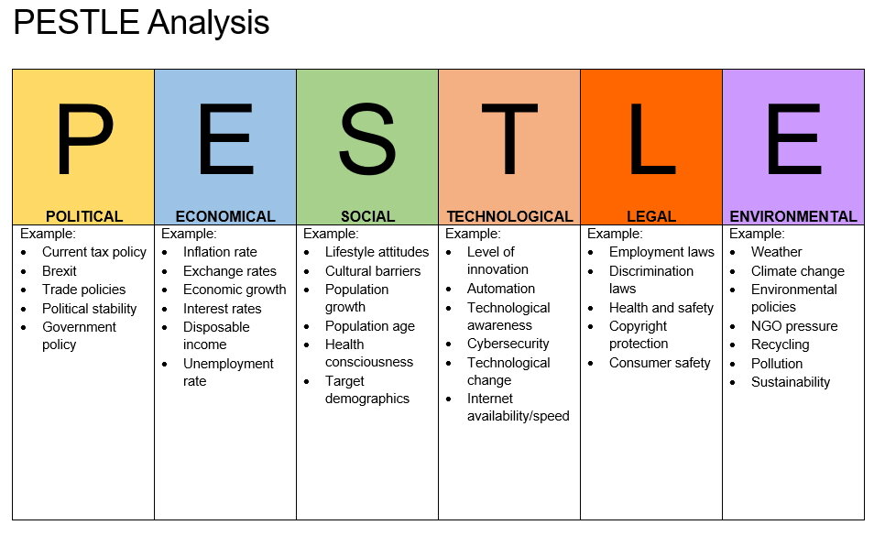

Slide 5
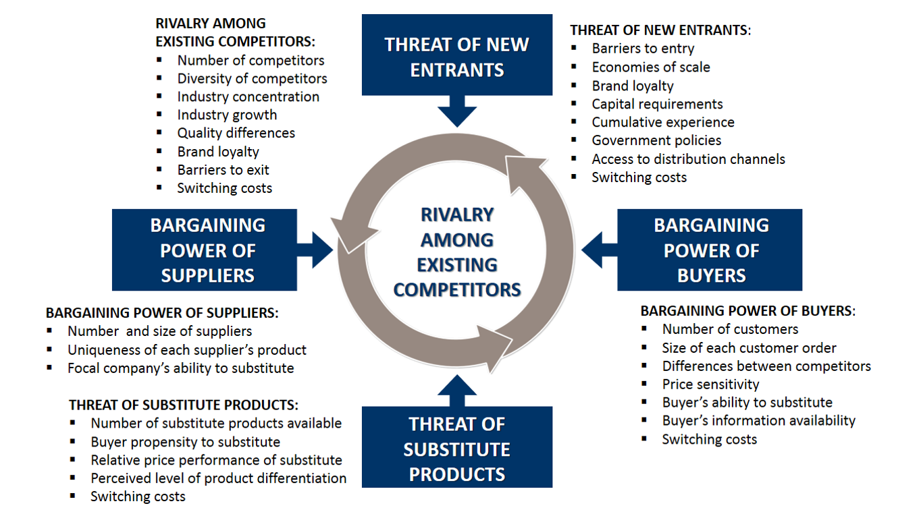

Slide 6
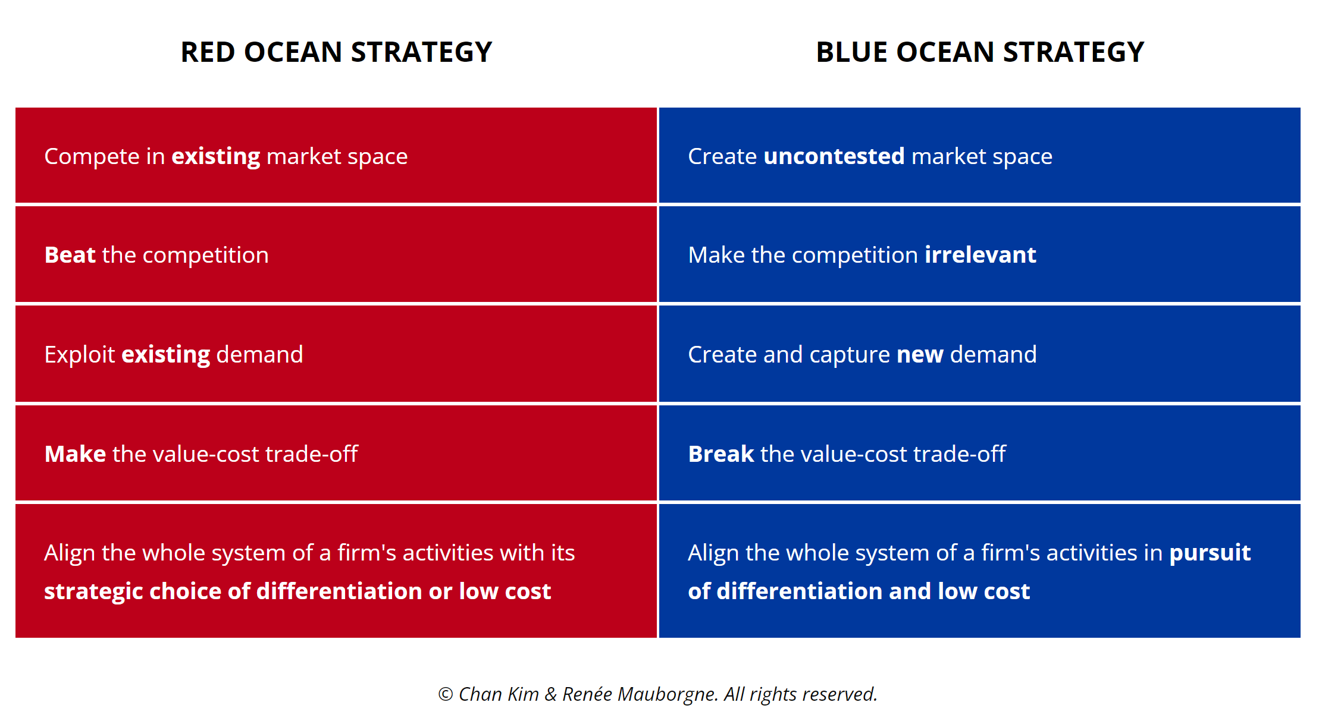
Bonus – Blue Ocean
Notes:
Cirque de Soleil

Slide 7
Notes:
Company is a collection of individuals

Slide 8
5. Back to the Harley
A - Understand your core purpose
B – Understand the external environment
C – Understand your industry
D – Understand the potential opportunities
E – Understand how you may be placed to maximise the opportunities and where the gaps are
Thought for next time – who is your conservatory?

Slide 9
Catherine.johns@wearecreative.uk

