Slide 1
Webinar 4: Know Your Journey
Maximising market opportunities

Slide 2
Topics
Where are we in the journey?
Understanding and assessing market opportunities
Yes/no decisions
Thought for next time

Slide 3
The journey:
Your core purpose – how can that be flexed and delivered?
External analysis – what is the landscape in which you operate?
Customer understanding – who else could want what you have?
= Market opportunities

Slide 4
How are you placed to take advantage of these opportunities?
= strategic choice.
Internal analysis needed!

Slide 7
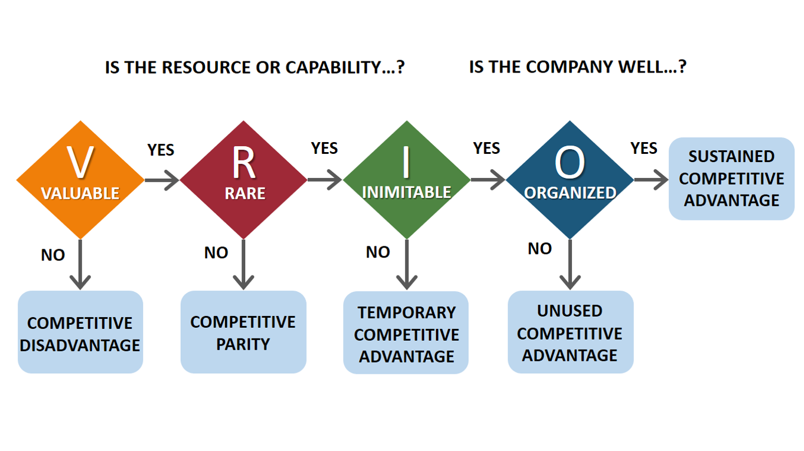

Slide 8
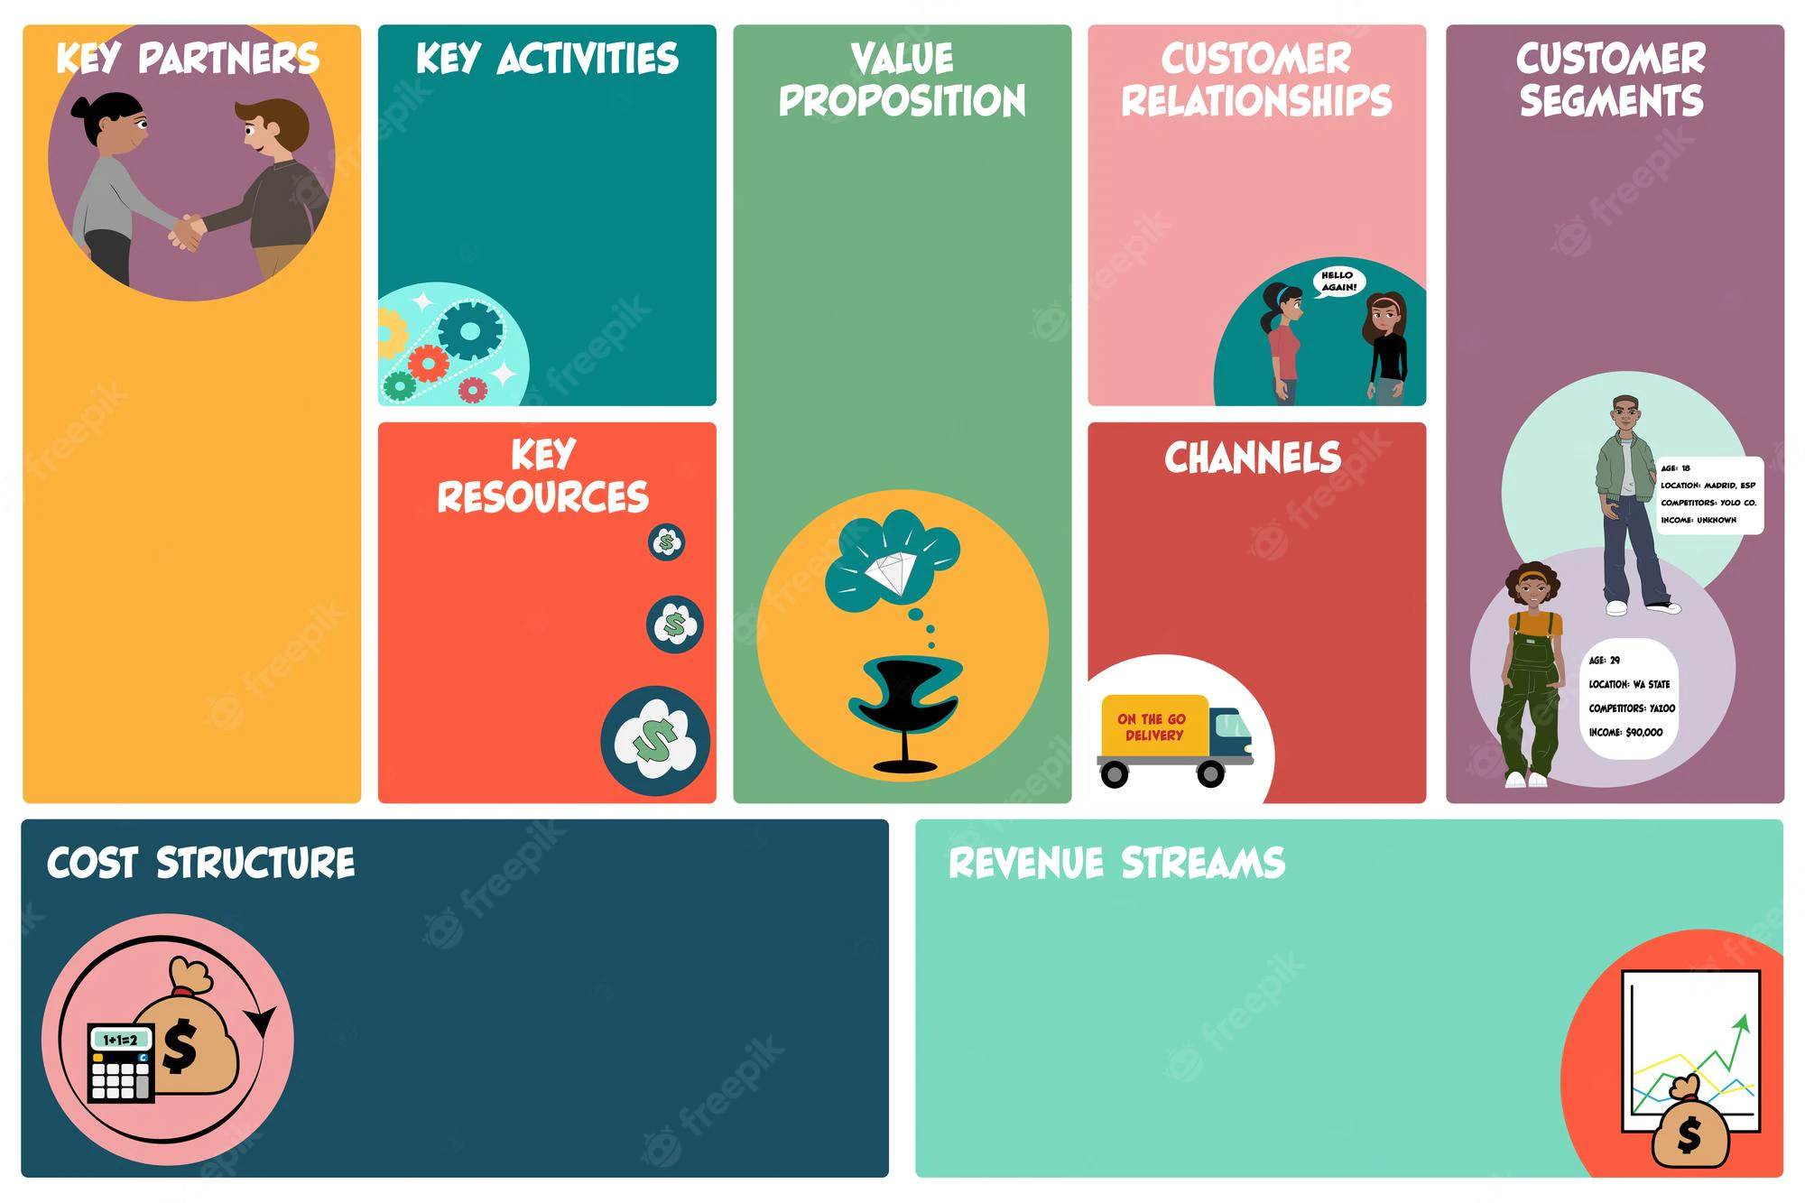

Slide 10
Yes/No:
Can we pursue this opportunity? Do we have the resources, skills, etc.? If not, what would it take to put them in place?
Should we pursue this opportunity? Does it align with our purpose, can we do it profitably and sustainably?

Slide 11
Final thought…

Slide 12
Catherine.johns@wearecreative.uk

